Slide 1
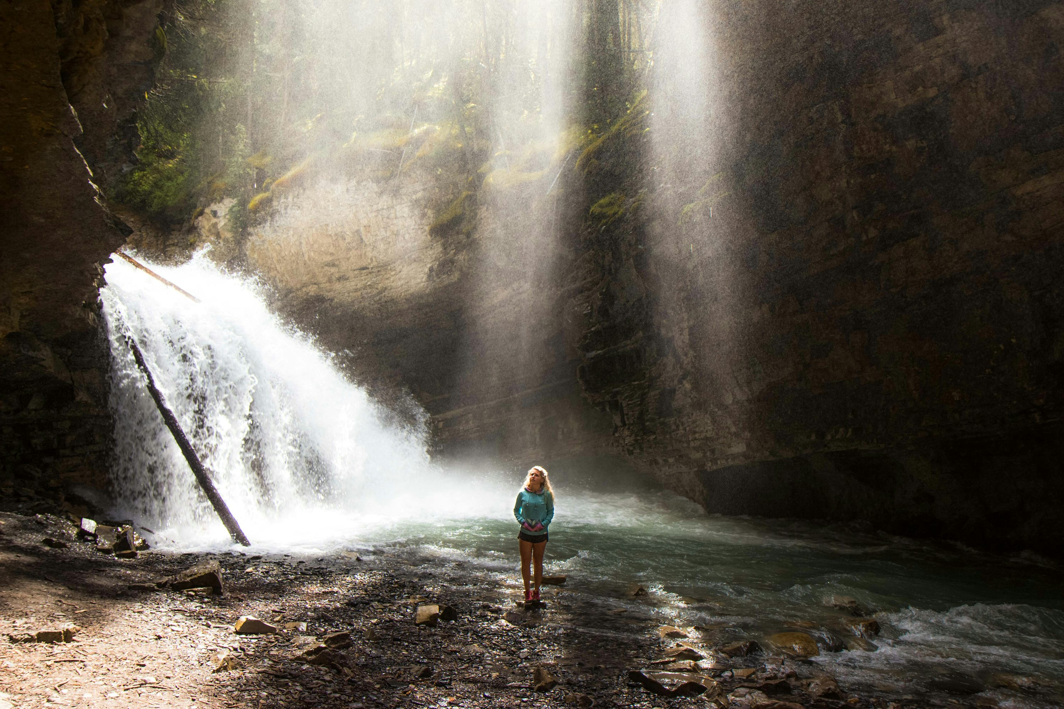
冒險故事 (Animaze)
Notes:
https://unsplash.com/photos/woman-standing-near-river-under-gray-sky-during-daytime-4mHZqgoZQu8
大家好，今天要跟大家分享冒險故事

Slide 2
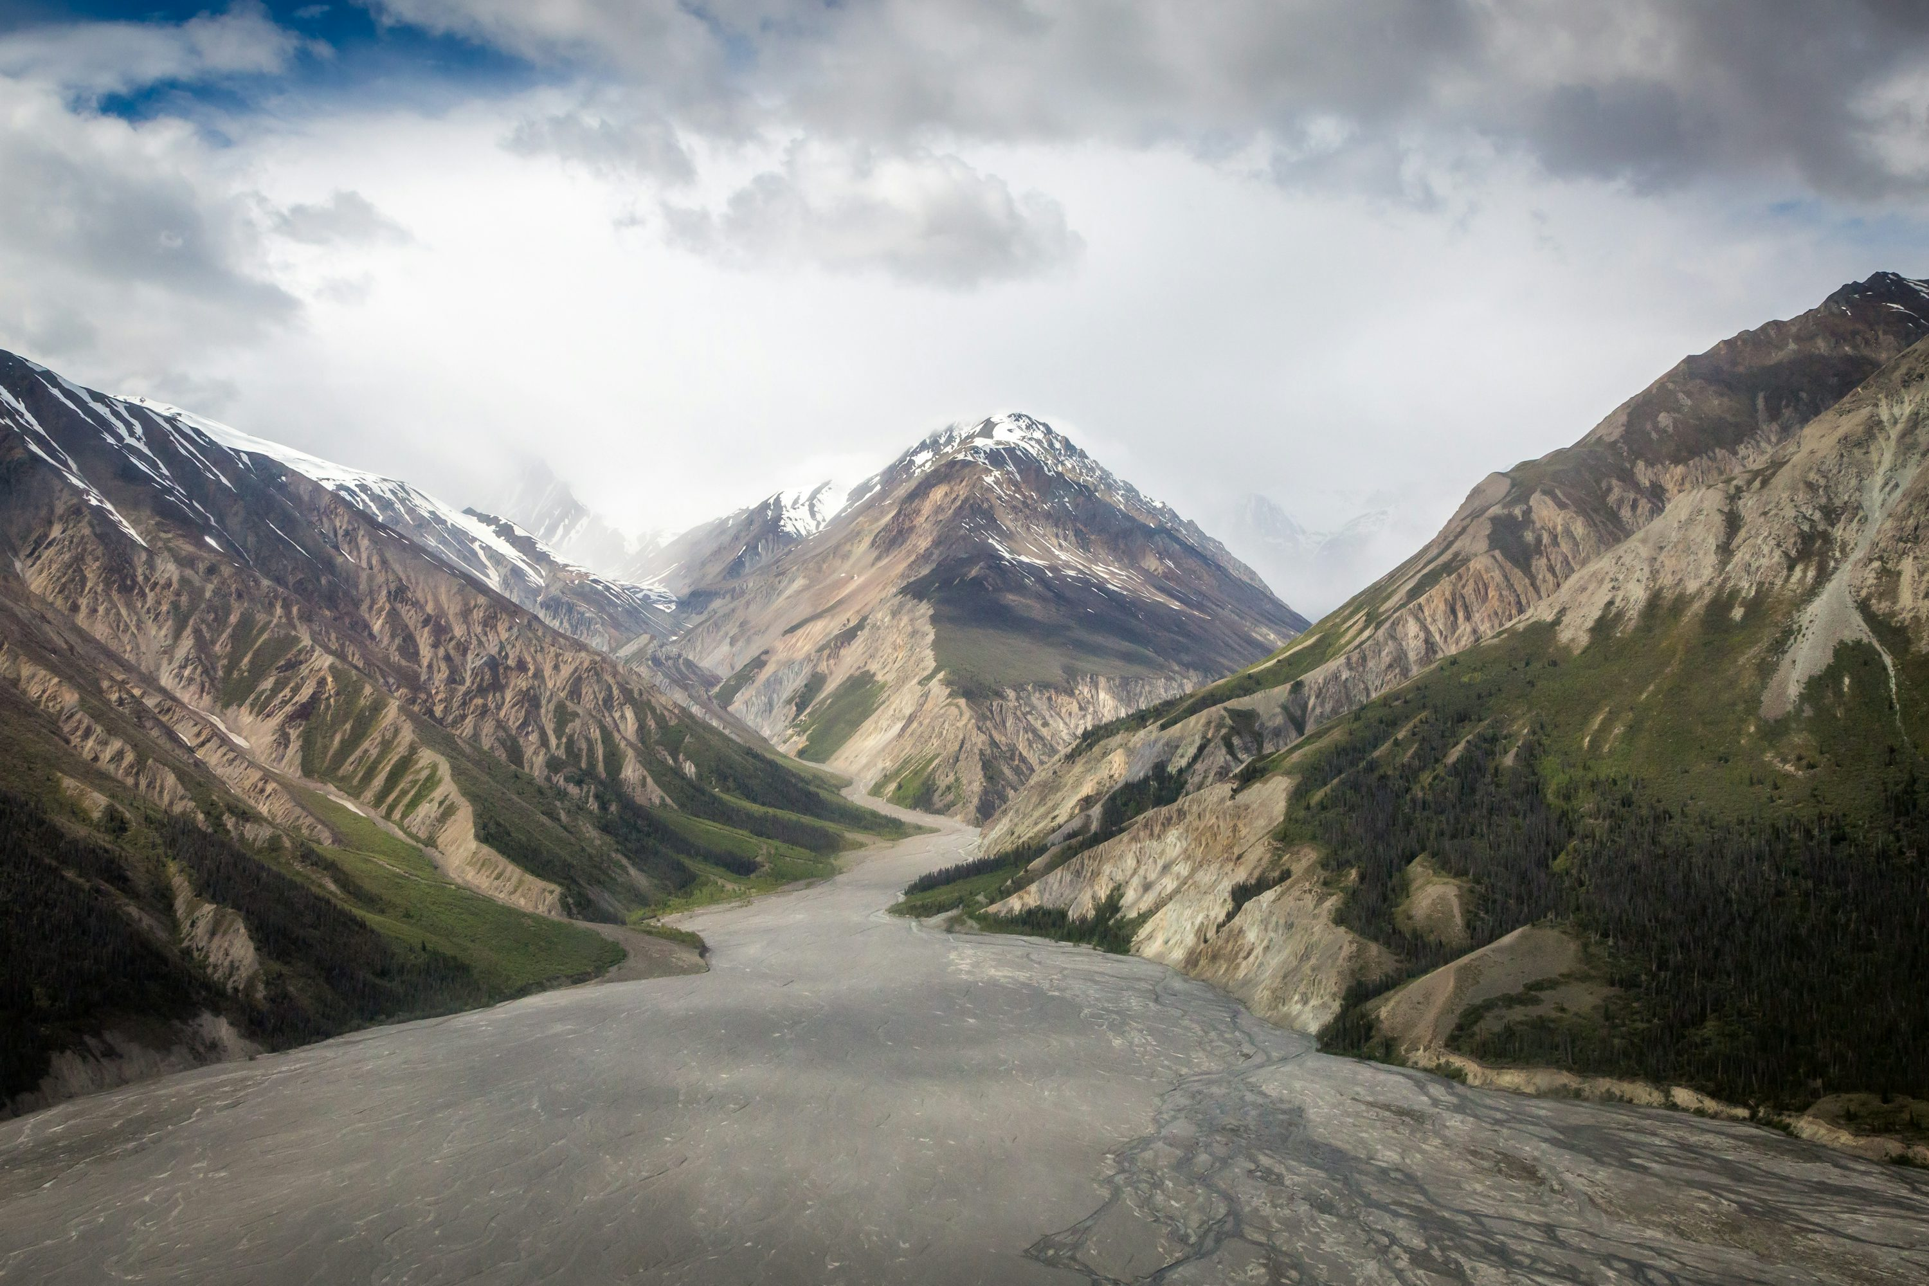


1.目標
Notes:
https://unsplash.com/photos/several-unsuccessful-attempts-at-a-red-arrow-that-missed-the-target-on-a-light-red-background-failure-in-attempts-to-achieve-goals-3d-render-illustration-pz_2DFD9ywY

Slide 3
Notes:
https://unsplash.com/photos/winding-road-through-mountain-INf4LQZwxRU
我是一個普通的高中生，從小就喜歡大自然和爬山

Slide 4
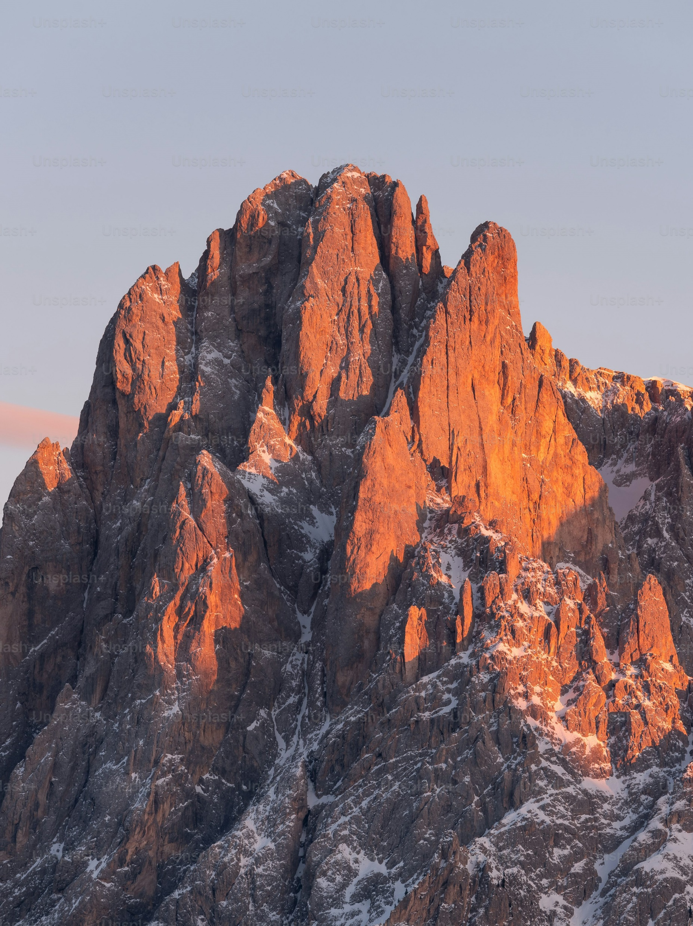
Notes:
https://unsplash.com/photos/a-very-tall-mountain-covered-in-snow-under-a-blue-sky-NNmiv6zcFvk
這次，我決定挑戰一座從未嘗試過的高山，這座山以其險峻的地勢和壯麗的景色聞名。我想要證明自己不僅能爬到山頂，還能超越自己心中的恐懼。

Slide 5
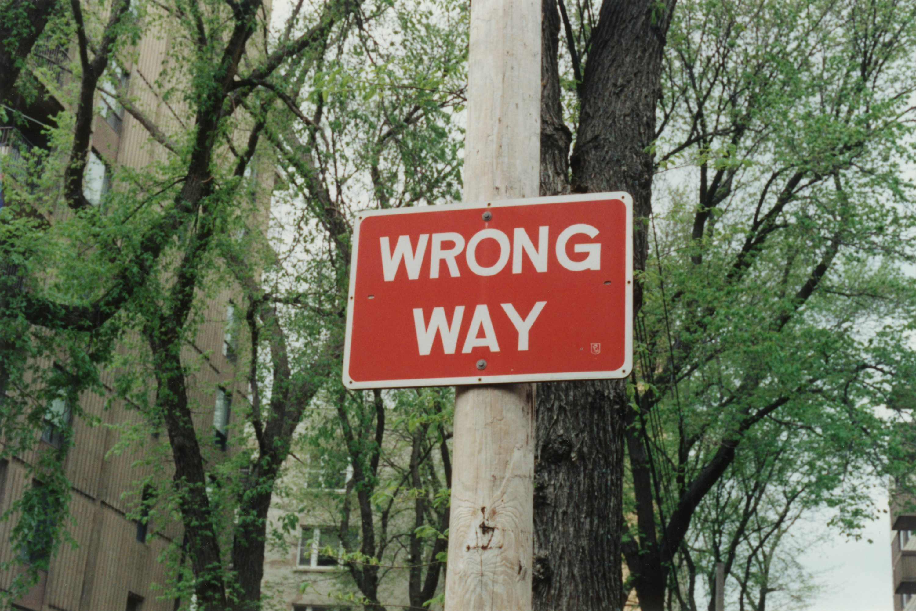
2.阻礙
Notes:
https://unsplash.com/photos/red-and-white-no-smoking-sign-duTm7WvwN0U
然而，爬到一半的時候，天氣突然變了。

Slide 6
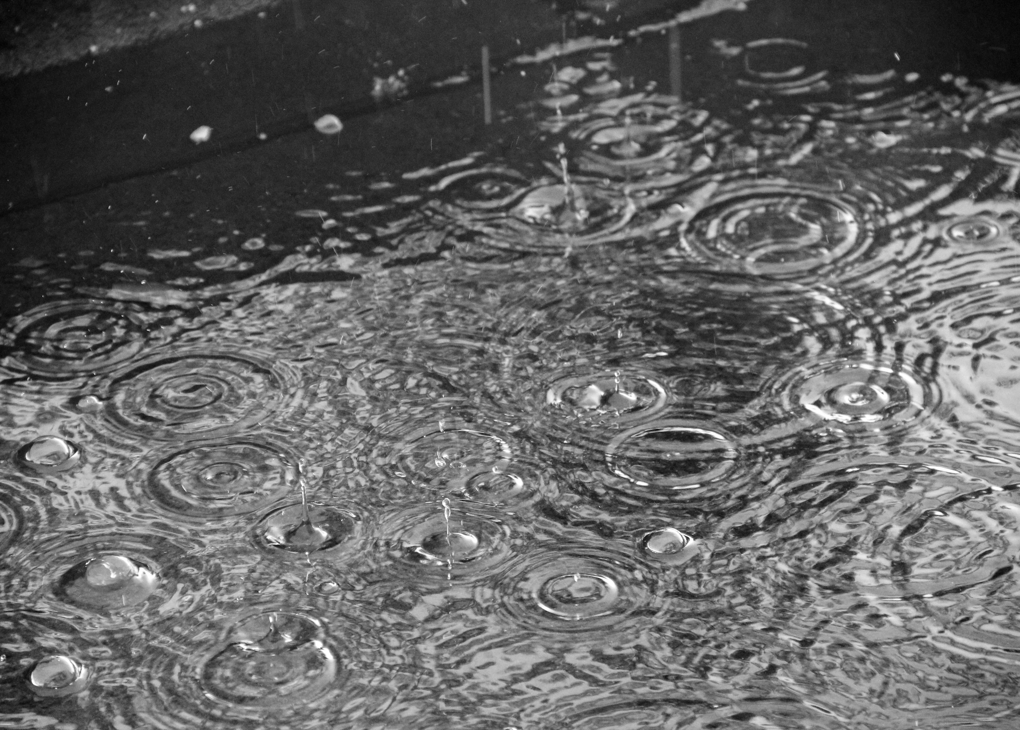
Notes:
https://unsplash.com/photos/a-black-and-white-photo-of-raindrops-in-a-puddle-pWzH7qOBpb0
原本晴朗的天空突然烏雲密布，強風帶來了暴雨，山路變得濕滑不堪。我帶的裝備不足以應對這麼惡劣的環境，風雨打得我眼睛幾乎睜不開，甚至開始懷疑自己是否應該繼續前行。

Slide 7
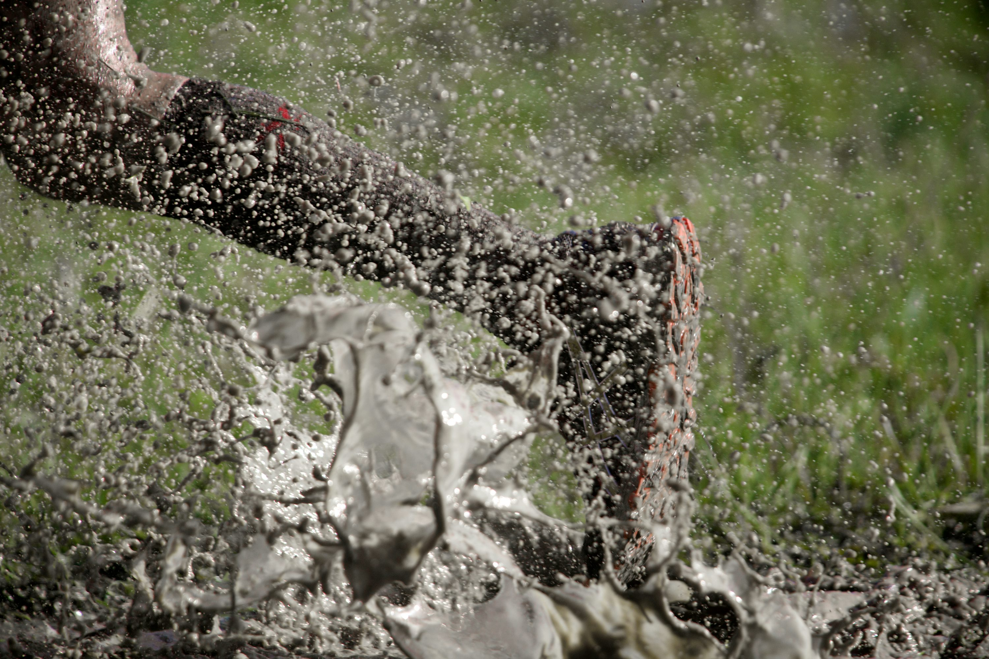
3.努力
Notes:
https://unsplash.com/photos/a-persons-legs-are-covered-in-mud-and-water-iz_HuFCttA8
儘管如此，我不想輕易放棄 回想起過去的訓練和每次登頂的成就，我決定咬牙堅持

Slide 8
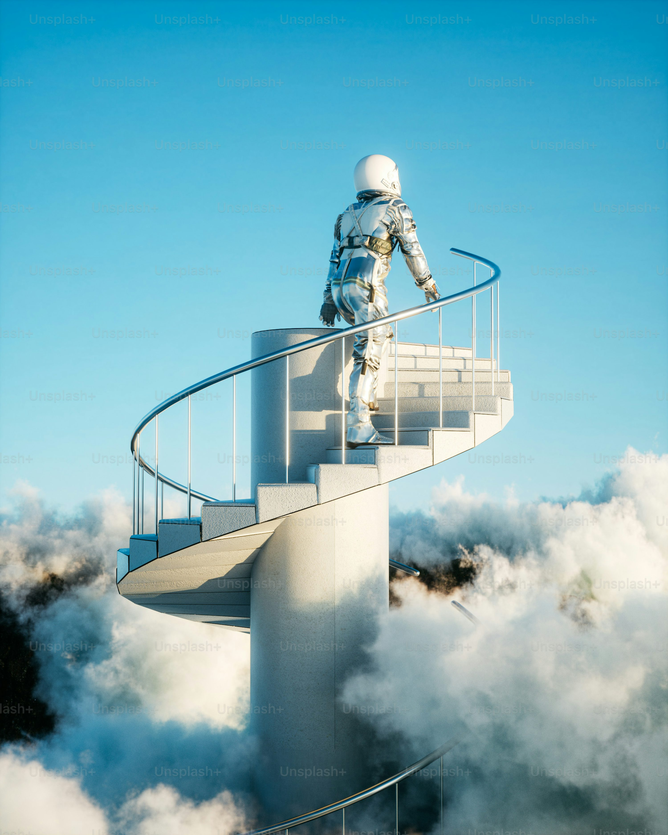
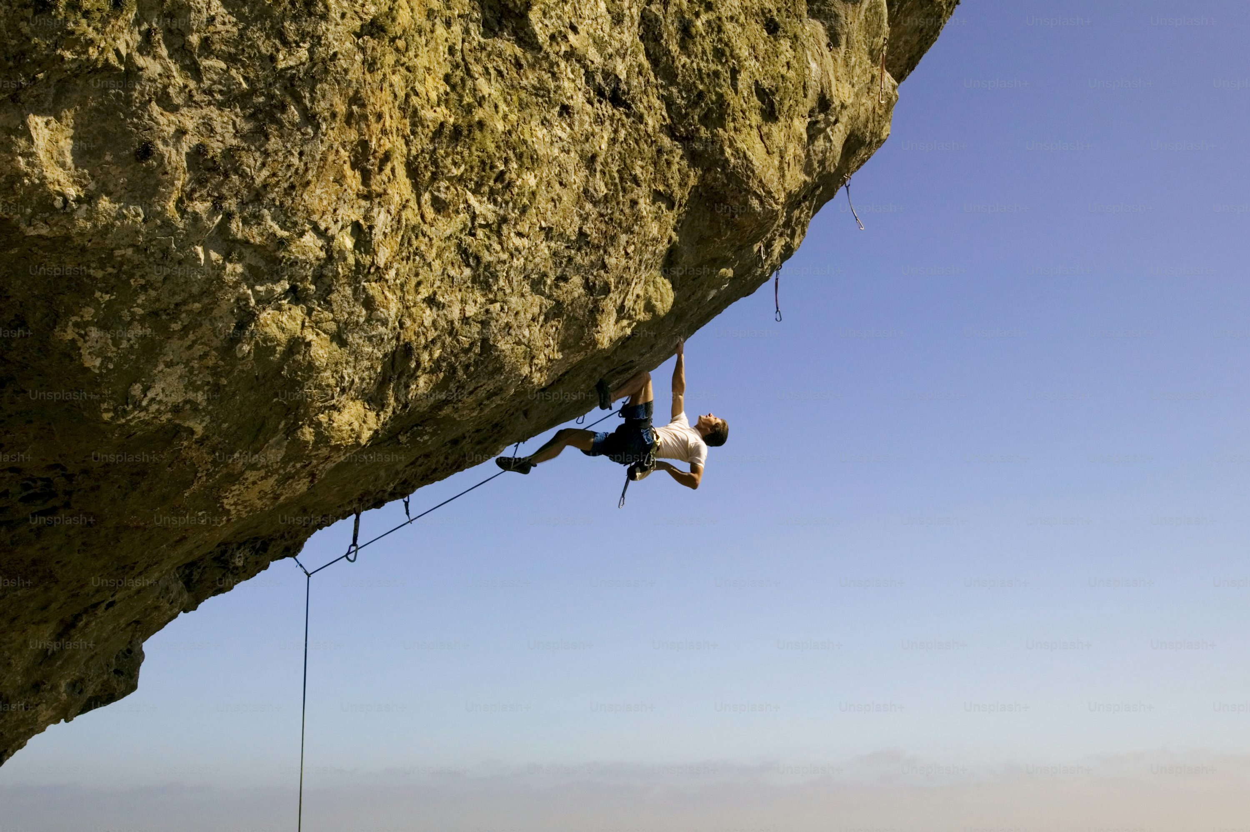
Notes:
https://unsplash.com/photos/a-man-climbing-up-the-side-of-a-cliff-uwra5qpX6pI
我小心翼翼地踩著濕滑的岩石，用雙手穩住自己，不斷告訴自己，只要一步一步前進，我就能走得更遠。我用力抓住每一塊岩石，每走一步都倍加謹慎。

Slide 9
4.結果
Notes:
https://unsplash.com/photos/a-man-in-a-space-suit-standing-on-a-spiral-staircase-9NfOoEqsH6c
終於，在歷經三個小時的掙扎後，我爬到了離山頂不遠的一個平台

Slide 10
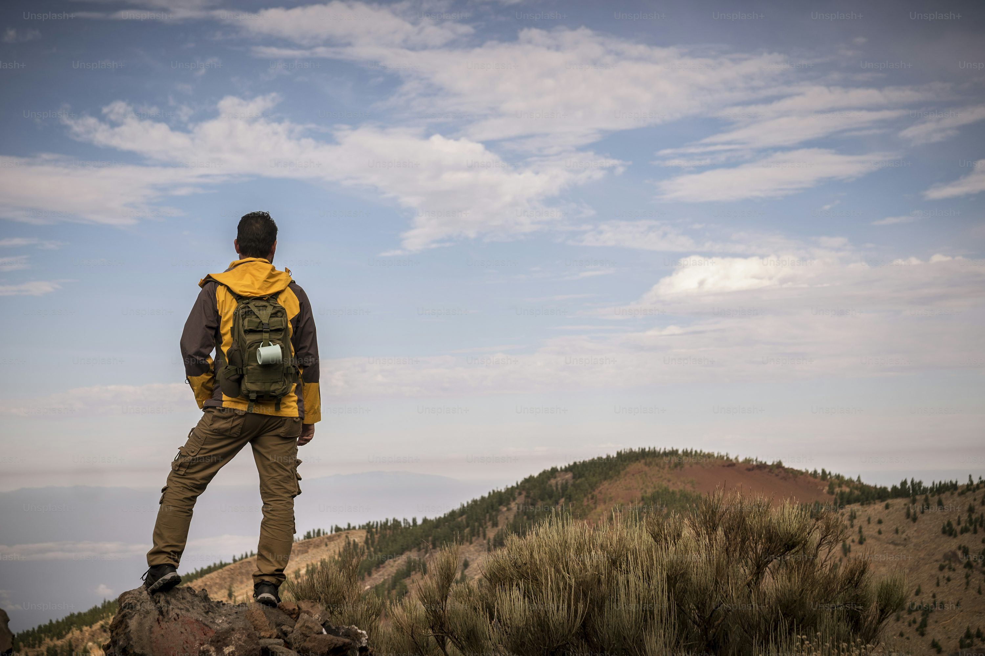
Notes:
https://unsplash.com/photos/lonely-man-in-trekking-adventure-discover-activity-at-the-mountain-with-backpack-hiker-looking-the-landscape-and-enjoying-the-wild-undiscovered-nature-beautiful-environment-for-alternative-vacation-DbfpMkDJc88
雨勢開始減弱，雲層也逐漸散開，我看到了久違的陽光。

Slide 11

5.意外
Notes:
https://unsplash.com/photos/man-in-white-dress-shirt-wearing-black-framed-eyeglasses-8RXmc8pLX_I
然而，就在我準備再度出發的時候，卻發現腳下的岩石裂開了一道縫隙。腳下突然鬆動，我整個人向下滑落！

Slide 12
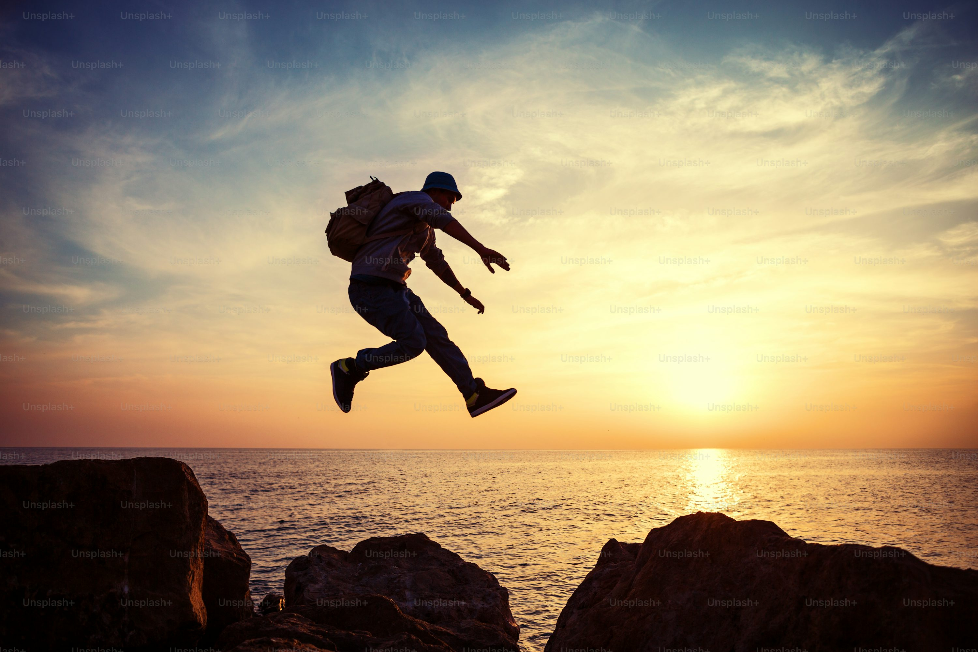
Notes:
https://unsplash.com/photos/brave-man-with-backpack-jumping-over-rocks-near-ocean-in-sunset-fCKTEpmfdkk
心跳瞬間加速，幸好我迅速抓住了身邊的一根樹枝，僅僅掛在山壁上。這一刻，我感到無比的恐懼和無助，心裡想著也許我應該回頭，這座山實在太危險了。

Slide 13
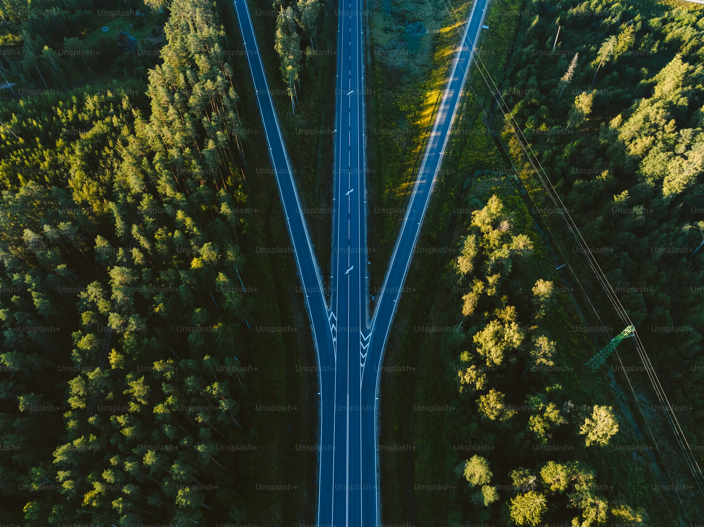
6.轉彎
Notes:
https://unsplash.com/photos/an-aerial-view-of-a-road-surrounded-by-trees-iDK1aeCB9zY
正在我猶豫是否該放棄時，我看到山下的景色，過往每一次的爬山經驗浮現心頭。

Slide 14
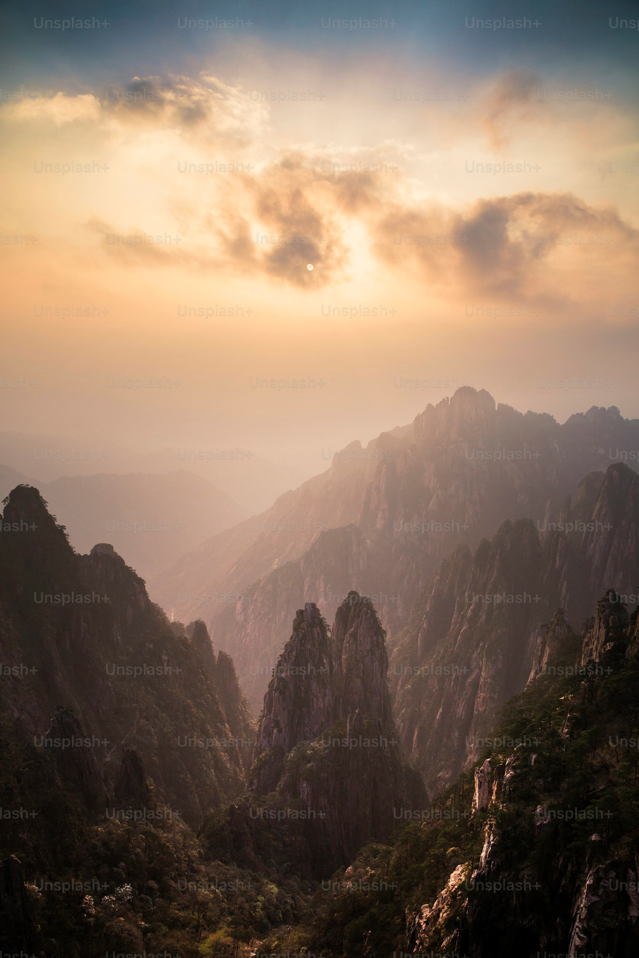
Notes:
https://unsplash.com/photos/the-sun-is-setting-over-a-mountain-range-FIjL4-xCSiU
我明白這是一次挑戰我的極限，也是一個學會面對困難的機會。我深吸一口氣，冷靜下來，利用身邊的樹木和岩石，重新找回了平衡，並想出了更安全的路線繞過裂縫。

Slide 15

7.結局
Notes:
https://unsplash.com/photos/a-woman-standing-in-a-field-with-her-hair-blowing-in-the-wind-gNNA9rJ5VSQ
最終，我克服了內心的恐懼與山道的險阻，成功登頂。

Slide 16
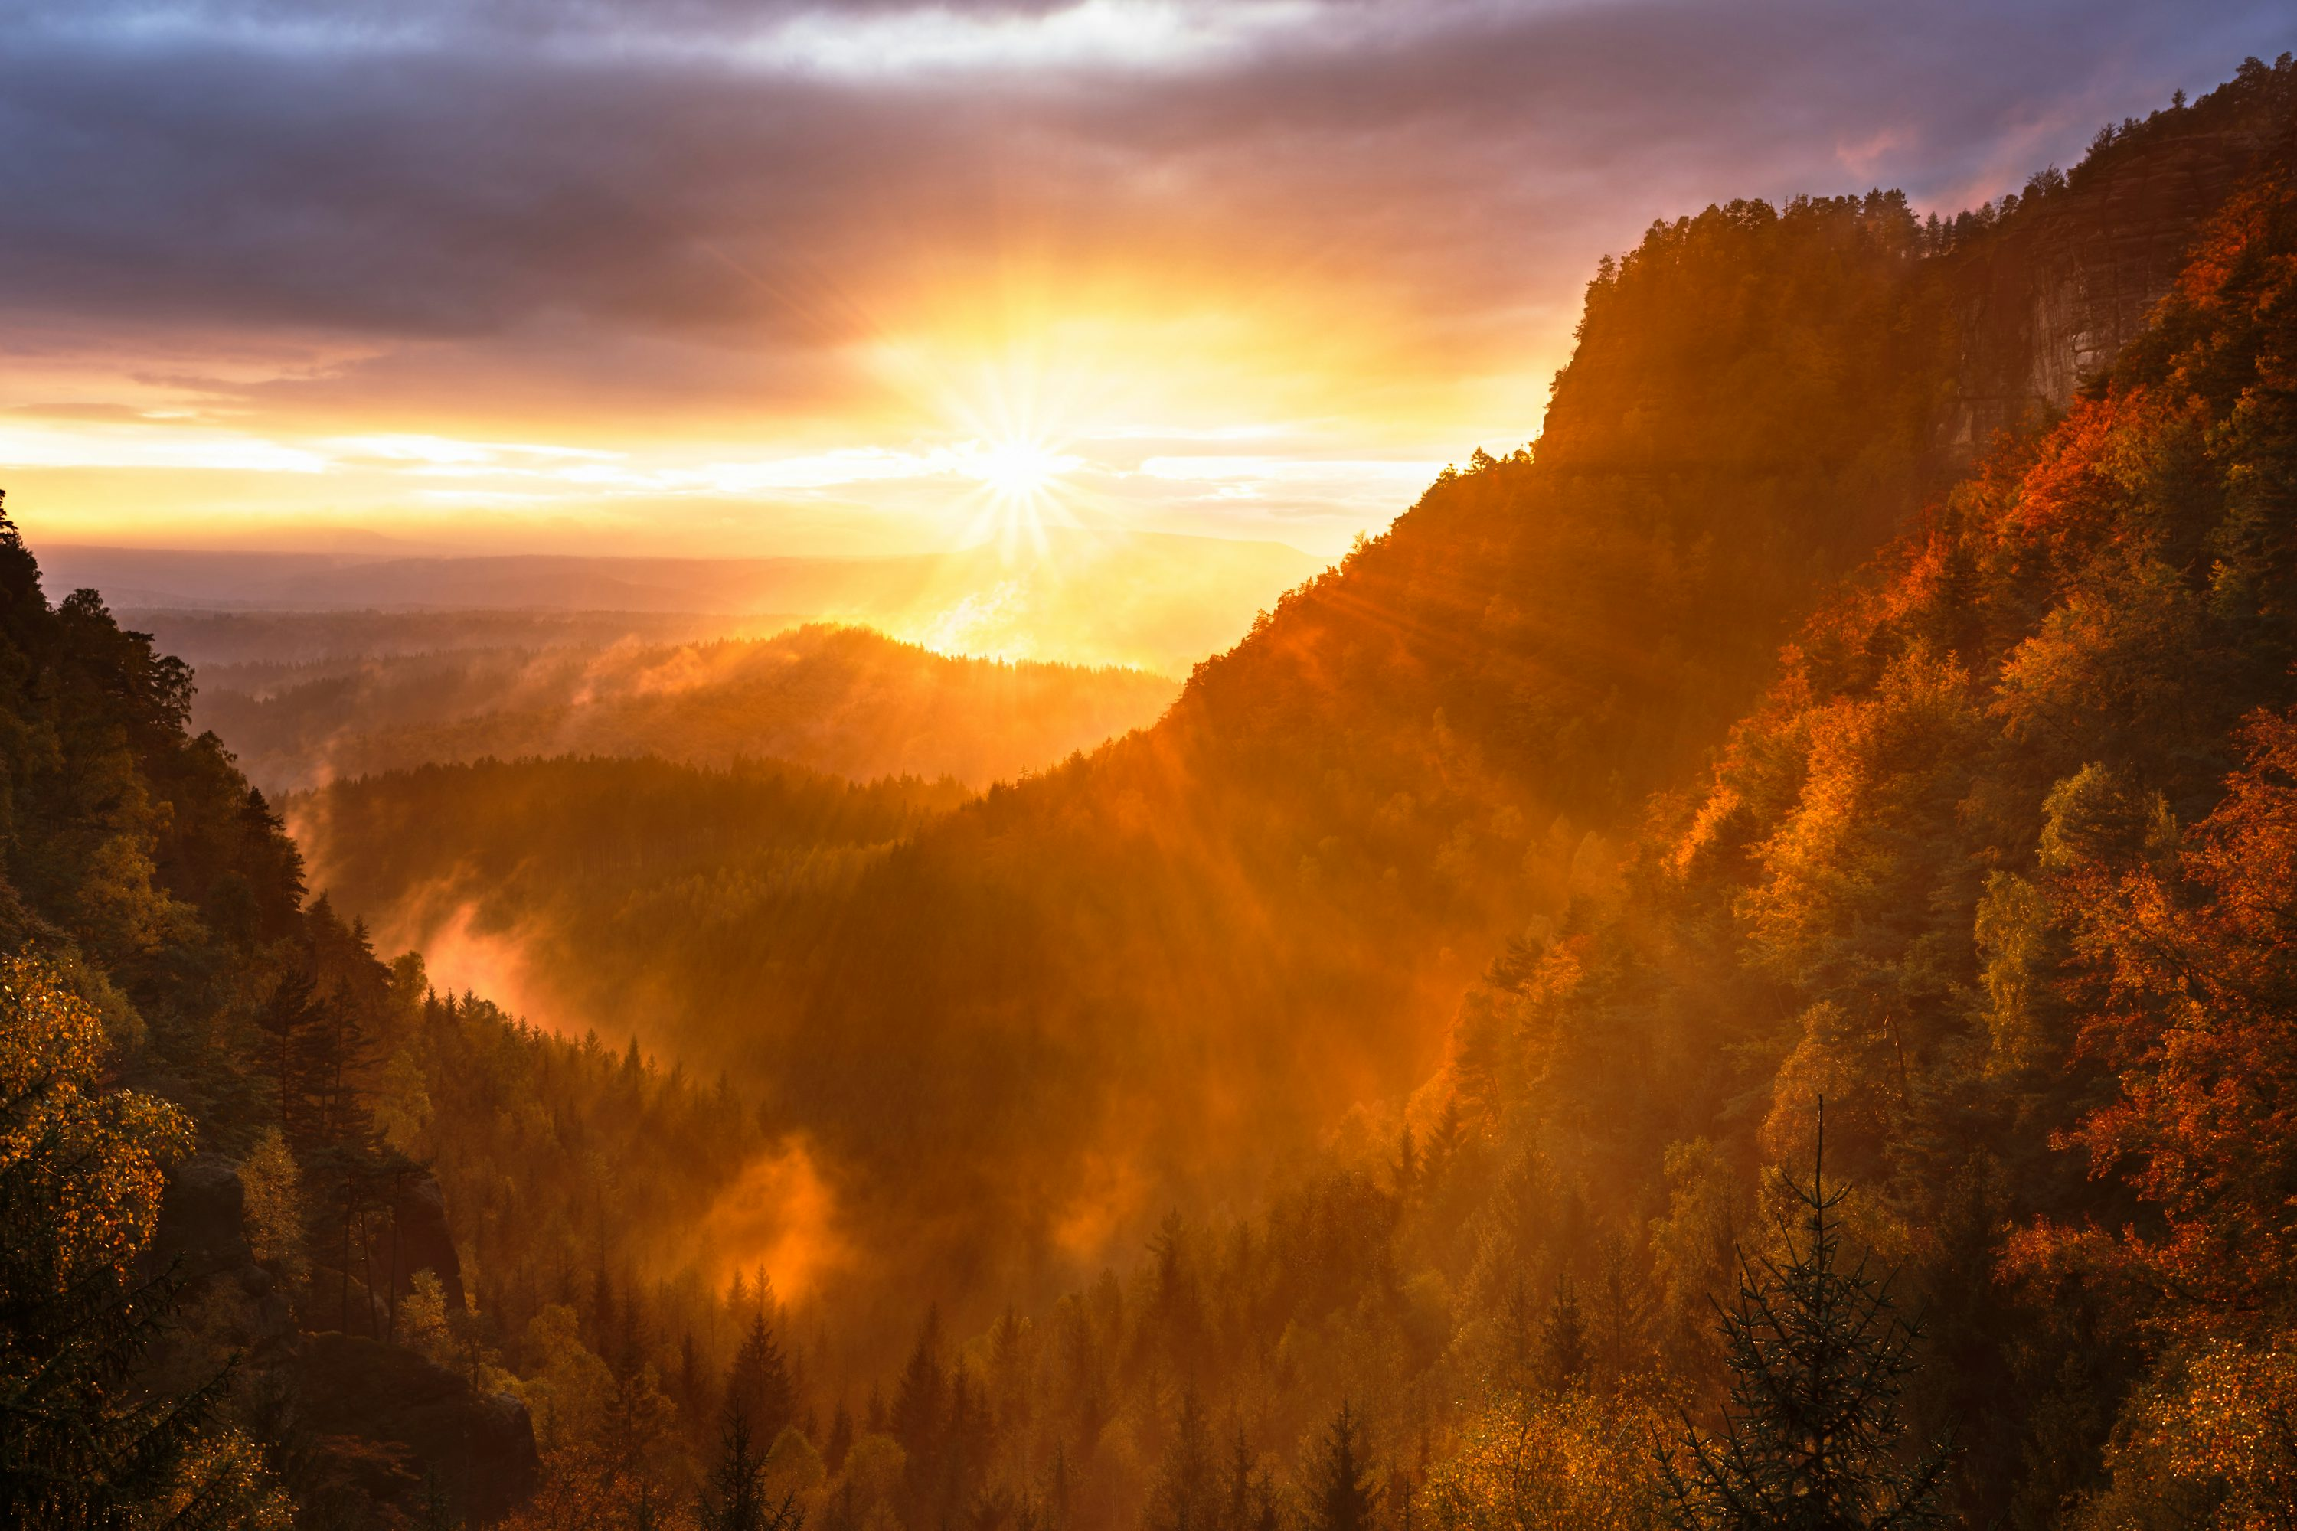
Notes:
https://unsplash.com/photos/mountains-and-tree-range-during-golden-hour-8c6eS43iq1o
站在山頂，俯瞰整片風景，雲海和陽光交織出一幅壯麗的畫面，我感到前所未有的成就感與平靜。這次爬山的經歷，不僅讓我看到了大自然的美麗，更讓我明白了如何在困難面前保持堅持與冷靜。

